Slide 1
Duplicate Question Pairs
Machine Learning project
Sanyam Sood
102003163
TIET

Slide 2
Problem Statement and Dataset Source
In 2017, Quora posted a competition on Kaggle. The challenge was to find out if a particular pair of questions are duplicate or not.
Quora is a platform to ask questions and connect with people who contribute unique insights and quality answers.
The dataset for the same was provided by Quora itself. It contains 4,04,290 pairs of questions.

Slide 3
Analysis of the given dataset.
It has 4,04,290 rows and 6 columns.
There are only 3 rows in which some data is missing. So, we can remove it without any problem
No row is duplicated.
Out of the total pairs, 2,55,027 pairs are non-duplicated and 1,49,263 are duplicated.
This amounts to a 63% to 37% distribution between non-duplicate and duplicate question pairs.

Slide 4
Simplest Approach: Bag Of Words (BOW)
Bag Of Words (BOW) is a simplifying model used in NLP for text modeling.
It is a representation of text that describes the occurrence of words within a document.
The words that occur in the question are converted into individual words such that each word becomes a feature and if the word is present in both the questions the value they get is 1 otherwise 0.

Slide 5
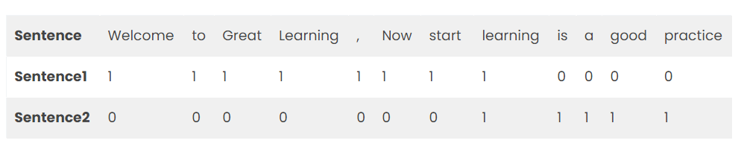
Steps in BOW
Two different sentences are taken.
A list of all the words that occur in these sentences is made.
Now, frequency of occurrence of these words is recorded with respect to these sentences.
This record is called BOW.
For example, Sentence1 -Welcome to great Learning, Now start learning. and,
Sentence 2-Learning is a good practice.

Slide 6
Preprocessing in Bag Of Words
All words are converted into lowercase
Special characters like commas are removed.
In some cases, stopwords that do not contain much information are removed.

Slide 7
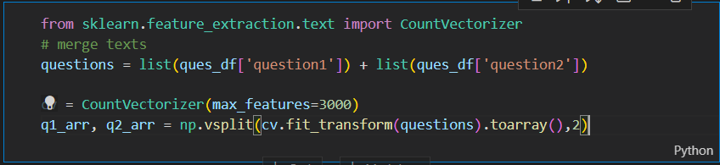
Countvectorizer
By using countVectorizer, we have made a list of 3000 features from each question pair and put them in a list.
Now, we have a list of 6000 features.

Slide 8
Random Forest Classifier
As the dataset is very large, we have taken a small sample of 50,000 question pairs.
By using Random Forest Classifier, we have split the dataset into train and test sets.
As the name suggests, Random Forest is a classifier that contains a number of decision trees on various subsets of the given dataset.
It then computes the average to improve predictive accuracy of the dataset.
Instead of relying on one decision tree, the Random Forest takes the prediction from each tree, and based on the majority votes of predictions, predicts the final output.
The greater the number of trees, higher is the accuracy and less is the chance of overfitting.

Slide 9
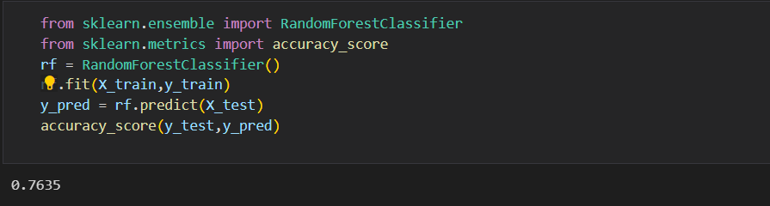
Accuracy in Random Forest Classifier
By Random Forest Classifier, we got an accuracy of 76.35%

Slide 10

How to increase Accuracy?
From the discussions on the contest, we observed that every team on the leaderboard has done some kind of Feature Generation in order to increase the accuracy
By increasing the number of features, we try to increase the efficiency of our model.

Slide 11
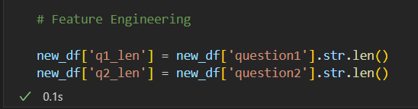
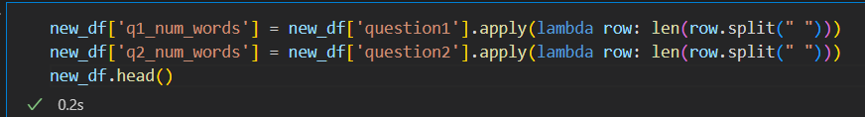
The Features we added
Q1len - Character length of Question 1
Q2len - Character length of Question 2
Q1words - Number of words in Question 1
Q2words - Number of words in Question 2

Slide 12
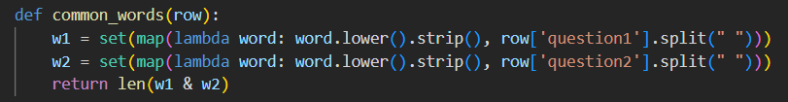
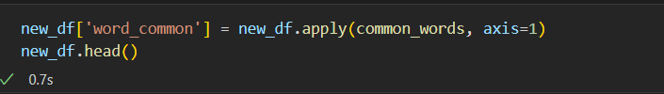
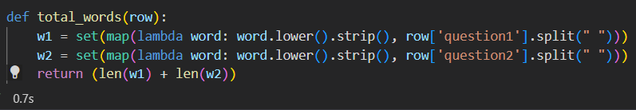

Wordscommon- Number of common unique words
Wordstotal- Sum of total number of words in both questions
Wordshare - ratio of words common to words total

Slide 13
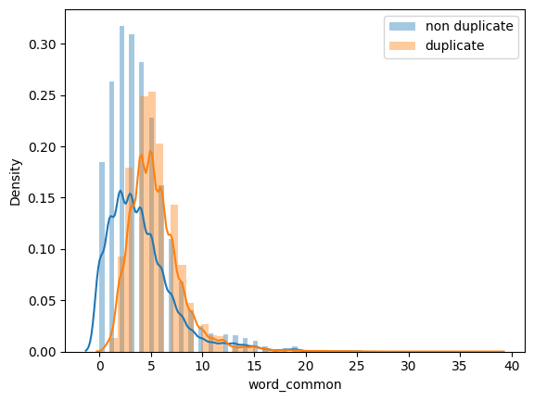
Analysis of the features
Both question pairs have similar average characters ( 59-60)
Both question pairs have similar average number of words (10-11)
When number of common words between pairs are less than 3, the pairs are more likely to be non-duplicated.

Slide 14
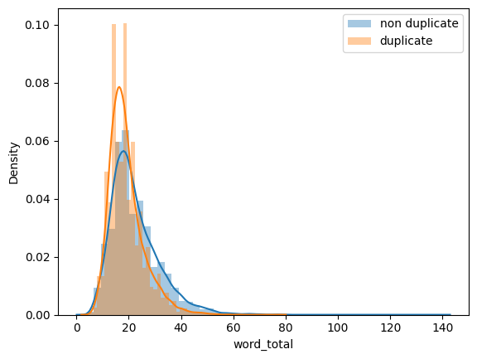
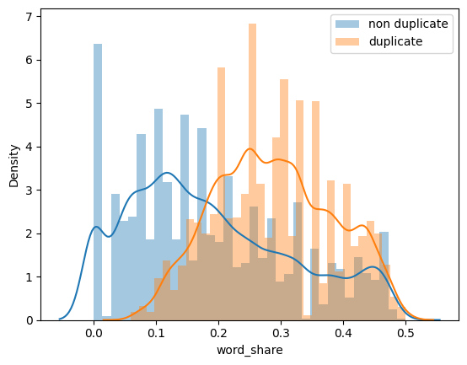
When total words are between 0-20, They are more likely to be duplicated and if total words are more than 20, the pairs are more likely to be non-duplicated
When word share between the pairs is less than 0.2, they are more likely to be non-duplicated and above 0.2, there is a higher chance that the pairs are duplicated

Slide 15
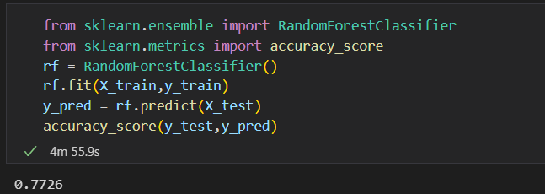
Accuracy after adding these features
After adding these features with earlier BOW, we get an accuracy of 77.2%

Slide 16
How To Improve Accuracy further.
On further research on the contest, we found some of the features that the winners adopted in order to increase the accuracy.
These features are divided into 3 categories-
Token Features.
Length based Features
Fuzzy Features

Slide 17
Token Features
Tokens- All words in the sentence.
Stopwords- All the words that are used in sentence forming.
Word- All tokens except stopwords are simply called stop words.
CWC-min: Ratio of number of common words to length of smaller question.
CWC-max: Ratio of number of common words to length of larger question.
CSC-min: Ratio of number of common stopwords to min number of stop words in pair.
CSC-max: Ratio of number of common stopwords to max number of stop words in pair.
CTC-min: Ratio of number of common tokens to larger token count between pair.
CTC-max: Ratio of number of common tokens to larger token count between pair.
Lastword-eq: 1 if last word of both question is same, 0 otherwise.
Firstword-eq: 1 if last word of both question is same, 0 otherwise.

Slide 18
Length Based and Fizzy Features
Length Based Features
Mean_len: Mean of the length of the two questions
Abs_len_diff: Absolute difference between the length of the two questions
Longest_substr_ratio: Ratio of length of the longest substring among the two questions to the length of the smaller question.
Fuzzy Features
Fuzz_ratio
Fuzz_partial_ratio
Token_sort_ratio
Token_set_ratio

Slide 19
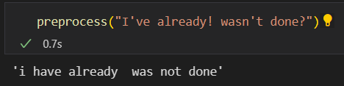
Further Preprocessing
On observing the dataset, we further processed the questions such that-
Replaced special characters with their string equivalents
Like ‘%’ into ‘percent’
Decontracting words
Like ‘ain’t’ into ‘am not’ etc
Removed HTML tags

Slide 20
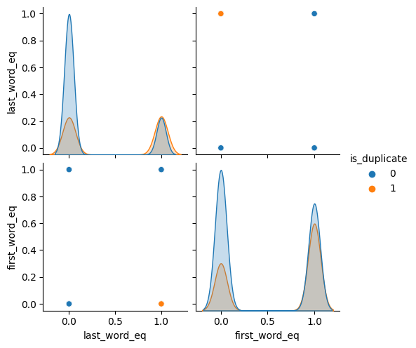
EDA on Advance Features
For first and last word equal features, we can observe that, if last word is not matching, there is a high probability that questions are not duplicated.
Same is with first word.

Slide 21
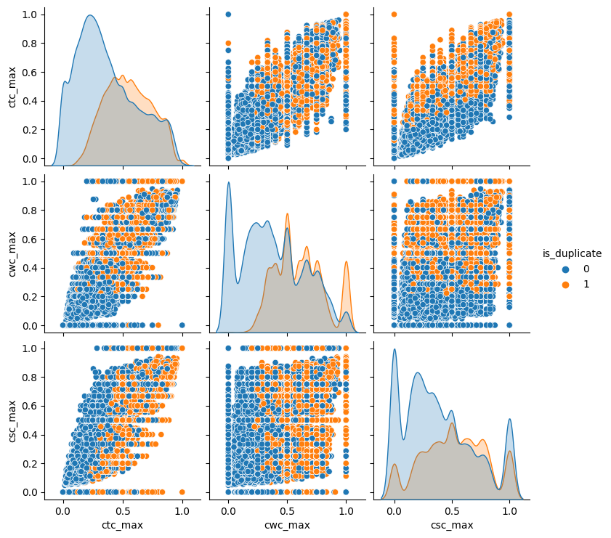
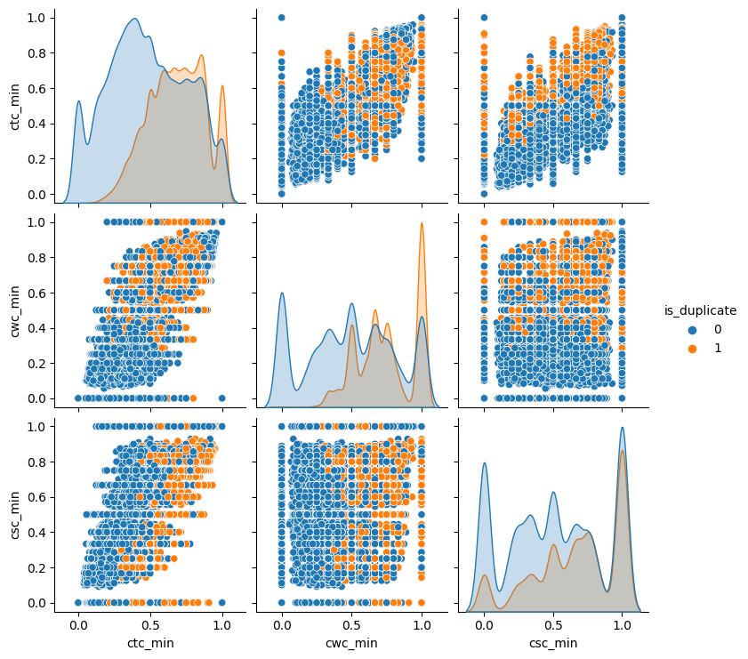
For Max and Min token features

Slide 22
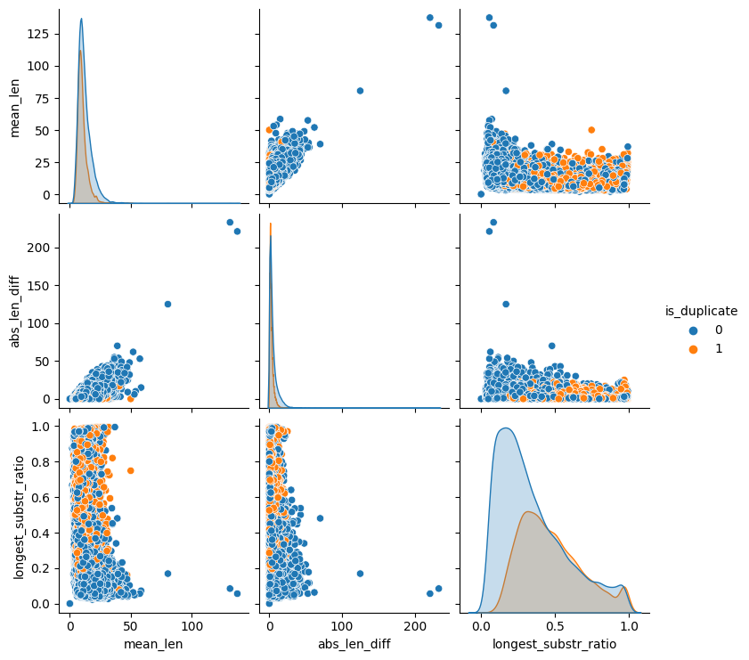
Length Based features
Here, mean length and average length are not the best we hope for, as the areas of both duplicated and non-duplicated are overlapping.
Longest substring ratio shows that, when the ratio is less than 0.5, the pairs are more likely to be non-duplicated.

Slide 23
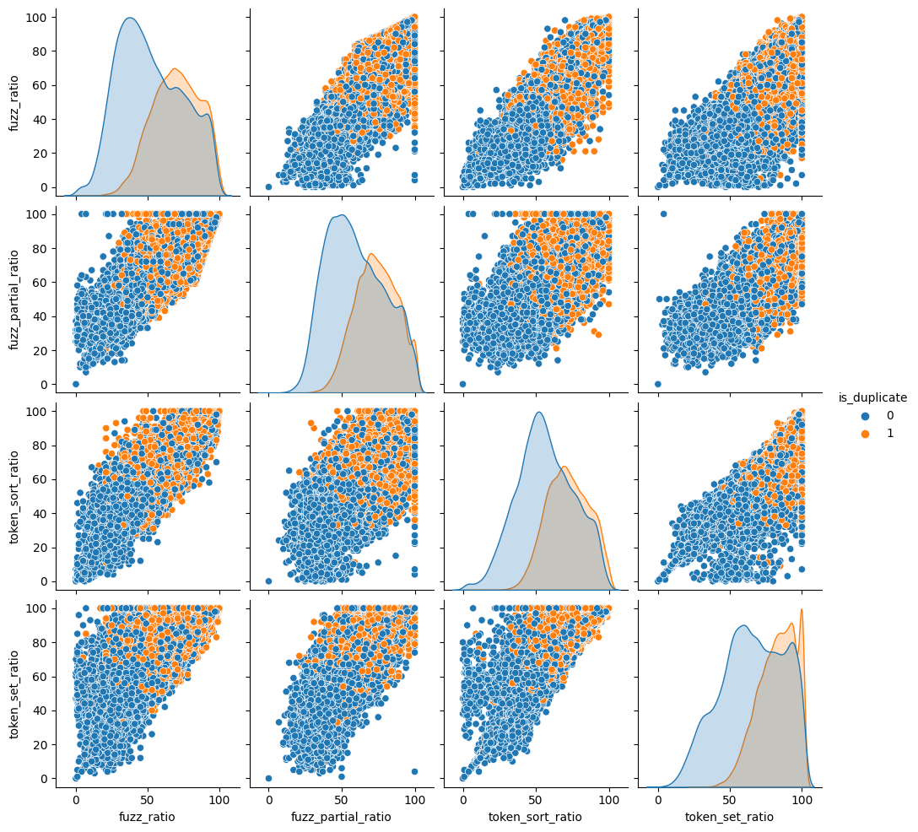
Fuzzy Features
All the Fuzzy ratio show that when the ratio is less, the pairs are more likely to be non-duplicated.

Slide 24
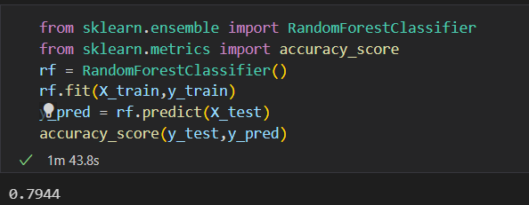
Accuracy of the model with all features.
After adding all the features, we now have a total of 22 features.
With these features we got an accuracy of 79.44%.

Slide 25
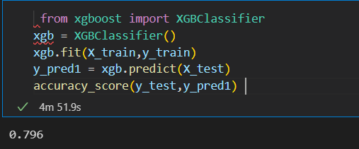
Other Model options
One of other famous model we can use is XGB classifier.
With XGB classifier, we actually get a higher accuracy of 79.6%

Slide 26
Which model should be adopted?
To answer that question, we have to keep in mind what we actually want from the model.
We need to know if the questions are similar or not, i.e., if we need to provide the same answer or different.
So, we need to observe how the misclassification will affect us.
Let’s plot the confusion matrix.

Slide 27
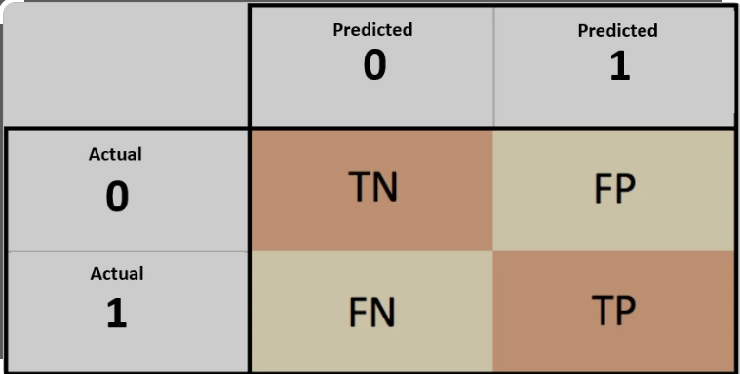
Confusion Matrix
For our particular problem, we will need the model such that it has less False Positive rate, because if the model predicts these questions as duplicated and they are actually non-duplicated, so the answer given by algorithm will not be correct.

Slide 28
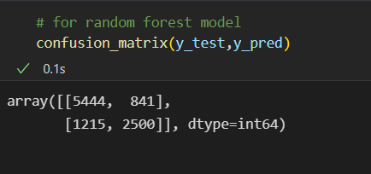
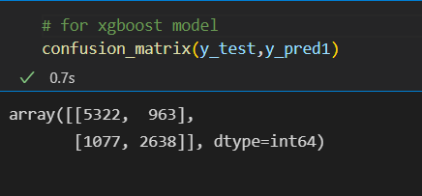
Comparison
As the False Positive (FP) rate of random forest classifier(841) is less than that of Xgboost(963), we will adopt random forest classifier for our model.

